Slide 1
- Become a Part of The Jewish Entrepreneur To Become a Mentor Email Robert Safren at robert@tjenetwork.com To Get Mentored, click on “Get a Mentor” on our website and fill out the form: tjenetwork.com

Slide 2
Marketing Modules
March 2022

Slide 3
Marketing Modules Topics
What is Marketing?
Advertising vs Marketing
Marketing;
Components, Funnel, 4 P’s,, Inbound/Outbound, Consumer Insights, Branding
Types of Marketing
Marketing Customer Insight
Branding
Marketing Strategy & Planning
Planning Process, Direction, Execution
Marketing Research
Personalization/Brand Loyalty
Marketing Innovation
Awareness
Social Media, SEO, Content
Digital Marketing
Social Media
Marketing Tools & Tactics
KPI’s- Key Performance Indicators
Marketing Budgeting & Marketing Spend
Maximize Marketing costs
Format, content and design of the information contained is not to be shared without written permission of Linda Feldman

Slide 4
What is Marketing?

Slide 5
Format, content and design of the information contained is not to be shared without written permission of Linda Feldman- lfeldman7370@gmail.com

Slide 6
What is Marketing?
Marketing is the process of creating awareness and promoting a business or brand’s products or services to a target audience.
Marketing focuses on utilizing data of target customer markets and developing strategies to reach the target market.
Format, content and design of the information contained is not to be shared without written permission of Linda Feldman- lfeldman7370@gmail.com

Slide 7
What is Marketing?
In every case, marketing’s purpose is to create visibility and awareness to potential customers who will then have an interest in the product and act by trial, purchase and hopefully becoming a brand or product ambassador as a regular user and tells others about the product.
Format, content and design of the information contained is not to be shared without written permission of Linda Feldman- lfeldman7370@gmail.com

Slide 8
What is Marketing?
Successful marketing programs are well planned and aimed at the target market/key user.
That includes development of marketing strategies and planning that resonates with the target market
and utilizing a communication plan within the marketing strategic plan, whether it is a robust website,
advertising digitally or through other channels to grow awareness to translate into purchases.
Strategic Marketing Plan includes the Communication Plan within it
Format, content and design of the information contained is not to be shared without written permission of Linda Feldman- lfeldman7370@gmail.com

Slide 9
What is Marketing?
Target Market- Older people
Emotional Angle and Message Tone
Discounted price
Free servicing & consult
Format, content and design of the information contained is not to be shared without written permission of Linda Feldman- lfeldman7370@gmail.com

Slide 10
What is Marketing?
Successful marketing programs are;
Strategic
Well planned and aimed at the target market/key user
Knowledge of target market/end user preferences are known through market research
Strategic Marketing Plan includes the Communication Plan within it
Communications plan is developed by creating the message, sharing that message via various mediums with the intent to create awareness among like-minded people to then create an action (purchase)
Format, content and design of the information contained is not to be shared without written permission of Linda Feldman- lfeldman7370@gmail.com

Slide 11
Advertising vs Marketing
“I need help with advertising!”

Slide 12
What’s the difference between Advertising & Marketing?
Advertising vs Marketing
Advertising
Promote a product/service/company
A component of Marketing
Develop the creative element to a message to use in advertising campaigns; often a catch-phase to resonate with consumers
Understand the target market or client segment
Utilize various media outlets based on the segment
Social media
TV, Print, Radio, Direct mail, Outdoor
Frequency- cadence to the ads running
Advertising determines how and where to share messaging
Marketing
Identify customer needs and deliver to those needs
Use research to reach the consumer; identifying consumer segments, create awareness and influence behavior
Marketing Four P’s; Product, Place, Price, Promotion
Create value proposition; features & benefits
Find & drive relevancy within the marketplace
Set Message & Tone
Overarching approach using strategic plans to drive a marketing plan and its messaging, advertising is one component of that plan
Format, content and design of the information contained is not to be shared without written permission of Linda Feldman- lfeldman7370@gmail.com

Slide 13
Advertising vs Marketing
Advertising
Creative element to a message used in advertising campaigns across advertising channels
Traditional advertising: print or TV messaging or communications.
Retail advertising: methods used in a retail location; in-store merchandising displays, signage
Digital advertising: Digital, or online includes placing ads, creating videos, guest posts, SMS, email, pay-per-click ads, and search engine optimization (SEO).
Format, content and design of the information contained is not to be shared without written permission of Linda Feldman- lfeldman7370@gmail.com

Slide 14
Advertising vs Marketing
Advertising
Creative element to a message used in advertising campaigns across advertising channels
Content advertising: providing readers with content that is educational and answers customer questions about products or services that customers are considering. Blogs, articles, video
Billboard ads: Billboard ads are placed in highly populated communities or tourist areas where those in traffic are most likely to view them.
Mobile advertising: utilizes people accessing the internet using their smartphones. Mobile advertising can be ads sent via text message or banner ads that appear on a mobile website.
Format, content and design of the information contained is not to be shared without written permission of Linda Feldman- lfeldman7370@gmail.com

Slide 15
Advertising vs Marketing
Advertising
Creative element to a message used in advertising campaigns across advertising channels
Newspaper advertising: Yes, it still exists! Brands may use display ads or classified listings in newspapers to promote their brand to people in specific locations
Direct Mail – similar to print advertising-.-goes directly into a home; circulars, postcards, mailers…
Format, content and design of the information contained is not to be shared without written permission of Linda Feldman- lfeldman7370@gmail.com

Slide 16
Advertising vs Marketing
Advertising
Creative element to a message used in advertising campaigns across advertising channels
Over-the-top advertising: Over-the-top marketing is newer and utilizes ad placement with video streaming services.
Advertising may include multiple types of campaigns that are specific to the target audience. Brands connect with and reach their target market through advertising.
Format, content and design of the information contained is not to be shared without written permission of Linda Feldman- lfeldman7370@gmail.com

Slide 17
- Become a Part of The Jewish Entrepreneur To Become a Mentor Email Robert Safren at robert@tjenetwork.com To Get Mentored, click on “Get a Mentor” on our website and fill out the form: tjenetwork.com

Slide 18
Marketing

Slide 19
Key Marketing Components
Marketing Four P’s; Product, Place, Price, Promotion
Elements that brands or business owners control to increase value and stand out against their competitors.
Marketing Funnel
Create value proposition; features & benefits
Use research & analysis to reach the consumer; identifying consumer segments and influence behavior
Strategic planning and Strategy implementation
Identify customer needs/demands and deliver to those needs/demands
Format, content and design of the information contained is not to be shared without written permission of Linda Feldman- lfeldman7370@gmail.com

Slide 20
Key Marketing Components
Find & drive relevancy within the marketplace
Set Message & Tone
Identify communication methods to create awareness
Translate awareness into action > interest, trial/purchase
Use data to; Measure the Return on Investment (ROI), Pivot tactics as needed
Format, content and design of the information contained is not to be shared without written permission of Linda Feldman- lfeldman7370@gmail.com

Slide 21
4 P’s of Marketing
Product
What is it?
Why would someone want it?
Price
Right sell price
Value proposition
Place
Know the customer journey
How and where they shop
Promotion
Does it exist in the marketplace?
Drive relevancy within the marketplace
Competitive features & benefits
Communication plan –comprehensive & flexible
Consistent content & messaging across all channels
Drive consumer action
Format, content and design of the information contained is not to be shared without written permission of Linda Feldman- lfeldman7370@gmail.com

Slide 22
Marketing -Product
Marketing Four P’s; Product, Place, Price, Promotion
Identify your product or service
What is it?
Why would someone want it?
Is there anything like it in the marketplace today?
How is this different? Points of Difference, why is this beneficial
Identify the customer needs/demands and how to deliver to those needs/demands
Format, content and design of the information contained is not to be shared without written permission of Linda Feldman- lfeldman7370@gmail.com

Slide 23
Marketing -Product
Marketing Four P’s; Product, Place, Price, Promotion
Use research to reach the consumer; identifying consumer segments and influence behavior
Create value proposition; features & benefits
Find & drive relevancy within the marketplace
Consider;
Functionality
Appearance
Warranty
Quality
Packaging
Format, content and design of the information contained is not to be shared without written permission of Linda Feldman- lfeldman7370@gmail.com

Slide 24
Marketing -Place
Marketing Four P’s; Product, Place, Price, Promotion
Identify how the customer shops to determine where to have your product and where to create awareness
If only on-line, then you will need a website where they can purchase and you can fulfill the orders
Will you need to build an eCommerce site, capable to have secure
Determine the best way to deliver to those needs
Understand the Customer journey
What are the steps they go through beginning with how they first came across your product, what they did once they became interested, what did they do when they were on your website….
Format, content and design of the information contained is not to be shared without written permission of Linda Feldman- lfeldman7370@gmail.com

Slide 25
Marketing -Place
Marketing Four P’s; Product, Place, Price, Promotion
Find & drive relevancy within the marketplace -create blogs, maintain content across all channels that is relevant and consistent
Use research to reach the consumer;
identifying consumer segments and influence behavior
Map the Customer journey
know how to reach them, improve the experience, lock-in by resonating
Format, content and design of the information contained is not to be shared without written permission of Linda Feldman- lfeldman7370@gmail.com

Slide 26
Marketing -Price
Marketing Four P’s; Product, Place, Price, Promotion
Establish the right price to sell
What is someone willing to pay for it?
Create value proposition; features & benefits
Points of difference (POD’s)
Consider production cost and the cost of marketing and advertising for healthy margins
Know the market, the industry, competition and distribution channels to determine what the market will bear
Format, content and design of the information contained is not to be shared without written permission of Linda Feldman- lfeldman7370@gmail.com

Slide 27
Marketing -Promotion
Marketing Four P’s; Product, Place, Price, Promotion
Promotion provides messaging or information about your products or services
Build a Communication plan that will create awareness and target the customer needs, wants desires
Use insights to reach and resonate with the consumer; identifying consumer segments and influence behavior
Promote using the appropriate vehicles based on consumer insights
Utilize the value proposition; features & benefits
Find & drive relevancy within the marketplace
Set Message & Tone
Format, content and design of the information contained is not to be shared without written permission of Linda Feldman- lfeldman7370@gmail.com

Slide 28
Marketing -Promotion
Marketing Four P’s; Product, Place, Price, Promotion
Understand all costs associated with execution of the Communications plan
Marketing Channels
Timing and frequency
Paid influencers
Design, copywriting, placement costs
Format, content and design of the information contained is not to be shared without written permission of Linda Feldman- lfeldman7370@gmail.com

Slide 29
The Marketing Funnel
Format, content and design of the information contained is not to be shared without written permission of Linda Feldman- lfeldman7370@gmail.com

Slide 30
- Become a Part of The Jewish Entrepreneur To Become a Mentor Email Robert Safren at robert@tjenetwork.com To Get Mentored, click on “Get a Mentor” on our website and fill out the form: tjenetwork.com

Slide 31
Types of Marketing

Slide 32
Outbound & Inbound Marketing
Format, content and design of the information contained is not to be shared without written permission of Linda Feldman- lfeldman7370@gmail.com

Slide 33
Inbound Versus Outbound Marketing
Marketing can also be categorized as inbound or outbound
Inbound marketing -provide value or information TO customers
Content marketing focuses on the customer before selling- informative blogs, influencers, social media
Inbound marketing works differently than outbound marketing by informing customers to buy when they are ready.
Inbound- users seek out brands/products to find information to suit their needs
Outbound marketing -directs advertisements and messages OUT to the customer
Brand goes after customers –TV commercials, print ads, direct marketing, billboards, instore displays, etc.
Pushes a message out - propaganda
Format, content and design of the information contained is not to be shared without written permission of Linda Feldman- lfeldman7370@gmail.com

Slide 34
Inbound Versus Outbound Marketing
Marketing can also be categorized as inbound or outbound
Inbound marketing
Provides value or information TO customers
Content marketing focuses on the customer before selling- informative blogs, influencers, social media
Inbound marketing works differently than outbound marketing by informing customers to buy when they are ready.
Outbound marketing
Directs advertisements and messages OUT to the customer
Brand goes out after customers –TV commercials, print ads, direct marketing, billboards, instore displays, etc.
Instead of the customer coming to the business to find information
Format, content and design of the information contained is not to be shared without written permission of Linda Feldman- lfeldman7370@gmail.com

Slide 35
Inbound Marketing
Consumers search for solutions online:
81% of customers research online before buying.
For B2B buyers, this is as high as 94%
54% of consumers make a purchase after seeing a product on Instagram
57% of customers use social media to get recommendations
Sources: Adweek, BloggingWizard, Mintel
Format, content and design of the information contained is not to be shared without written permission of Linda Feldman- lfeldman7370@gmail.com

Slide 36
Inbound Marketing
Inbound marketing is a strategic approach using consumer insights to create valuable content that aligns with the needs of your target market.
The content should inspire and nurture long-term customer relationships.
From attracting to delighting the customer, you know them and provide solutions to their problems.
Format, content and design of the information contained is not to be shared without written permission of Linda Feldman- lfeldman7370@gmail.com

Slide 37
Outbound vs Inbound Marketing
Outbound Marketing includes tactics such as ads, direct mails, trade shows, seminar series, email blasts, cold calling, etc. Think of marketers pushing their message out with the hopes it will bring people in.
These tactics are difficult to target and measure.
Traditional push-pull marketing
Inbound Marketing uses tactics such as content marketing, blogging, and social media to bring people into your organization with helpful content and targeted strategies.
An inbound marketing strategy is measurable and digital, since tactics target a specific audience online (instead of throwing a wide-casted net at everyone.)
Sources;https://www.stateofinbound.com/ and https://www.hubspot.com/marketing-statistic
Format, content and design of the information contained is not to be shared without written permission of Linda Feldman- lfeldman7370@gmail.com

Slide 38
Inbound Marketing
Statistics on Inbound
68% of inbound marketers and only 48% of outbound marketers classify their marketing efforts as “effective.”
Inbound gives higher ROI. 46% of marketers reported that inbound marketing gave a higher ROI, while only
12% reported outbound did.
Inbound produces higher quality leads for sales. When asked which marketing tactic provides higher quality leads;
59% of marketers responded inbound, and 16% reported outbound.
When asked which marketing tactic provides higher quality leads for the sales team, 59% of marketers responded inbound and 16% reported outbound.
Sources;https://www.stateofinbound.com/ and https://www.hubspot.com/marketing-statistic
Format, content and design of the information contained is not to be shared without written permission of Linda Feldman- lfeldman7370@gmail.com

Slide 39
Outbound Marketing -Statistics
Companies that published over 16 blog posts per month received roughly 3.5X more
traffic than companies that published 0-4 blogs per month.
B2B companies that blogged over 11 times per month received 3X more traffic than B2B companies that
blogged 0-1 time per month.
47% of buyers view 3-5 pieces of the company’s content before talking with a sales representative.
96% of B2B buyers want content that has input from industry thought leaders.
Content consumption on Facebook grew 57% over the last two years.
Buyers from Pinterest spend 20% more than buyers referred from non-social channels, including search.
66% of marketers see lead generation benefits with social media after only six hours of week dedicated to social media marketing.
80% of companies not meeting their revenue goals receive 10,000 monthly website visitors or less.
Related article: 5 Reasons Your B2B Marketing Campaign Failed (And How to Fix It)
Sources;https://www.stateofinbound.com/ and https://www.hubspot.com/marketing-statistic
Format, content and design of the information contained is not to be shared without written permission of Linda Feldman- lfeldman7370@gmail.com

Slide 40
- Become a Part of The Jewish Entrepreneur To Become a Mentor Email Robert Safren at robert@tjenetwork.com To Get Mentored, click on “Get a Mentor” on our website and fill out the form: tjenetwork.com

Slide 41
Marketing Customer Insight

Slide 42
Marketing; Facts vs Insights
Facts/Observations
What the user said or did
A statement or fact with no interpretation
Often comes straight from a research report or debrief
Is something that was observed or heard
Insights
Why the user said or did it
Expressed as a want, need, belief or feeling
Is an accurate reflection of reality
Offers a fresh perspective, even if obvious once found out
Is simple, non-technical and understood by all
Is action orientated
Format, content and design of the information contained is not to be shared without written permission of Linda Feldman- lfeldman7370@gmail.com

Slide 43
Marketing – Customer Insight
Market Research to gather data to better understand the customer –gain insight
Voice of the Customer (VOC)
Use consumer insights to create valuable content that aligns with the needs of your target market
Identify opportunities to achieve competitive advantage by generating insights into end-users/specifiers, shoppers or customer needs, market trends and competitive activity
Format, content and design of the information contained is not to be shared without written permission of Linda Feldman- lfeldman7370@gmail.com

Slide 44
Marketing – Customer Insight
***Insight should drive all elements of the marketing mix***
Findings
What the user said or did
Why?
Why?
Insights
Why the user did what he did or said what he said
Format, content and design of the information contained is not to be shared without written permission of Linda Feldman- lfeldman7370@gmail.com

Slide 45
Marketing; Insight
Identify emerging market trends
Build close connections with end-suers, influencers, distribution channels
Plan & interpret market research, customer data from various sources
Website, on-line orders, mix, feedback, etc.
Format, content and design of the information contained is not to be shared without written permission of Linda Feldman- lfeldman7370@gmail.com

Slide 46
Marketing; Insight
Develop insightful segmentation data about the customer
Where they shop, what they do, How they are influenced, What are their problems
Watch the marketplace activity
See what your competitors are doing; where they create awareness, their messaging, their POD’s, pricing, website links, promotions, etc.
Understand the market to have a forward-thinking view
Leverage Consumer Insights
Gain meaningful insights about consumers by understanding their media habits at the individual, community and cultural level.
Format, content and design of the information contained is not to be shared without written permission of Linda Feldman- lfeldman7370@gmail.com

Slide 47
Marketing; Insight
How to gain consumer insight:
Trends & market analysis- identify patterns in information
People who buy this….frequently purchased together…..
Interviews
in store, in shopping malls, phone, emails….
Custom surveys
follow up after a trip, shopping, purchase, email after service
Focus groups
In person group interview
Similar demographics, similar traits/experiences
Track reactions/feedback to posed questions
Format, content and design of the information contained is not to be shared without written permission of Linda Feldman- lfeldman7370@gmail.com

Slide 48
- Become a Part of The Jewish Entrepreneur To Become a Mentor Email Robert Safren at robert@tjenetwork.com To Get Mentored, click on “Get a Mentor” on our website and fill out the form: tjenetwork.com

Slide 49
Branding

Slide 50
Key elements of Branding
A Brand is not the business, it is a vehicle or component of the business as a specific product and products that may fit under its umbrella
J&J or Coca-Cola have many brands and sub-brands
Brand essence, reason for being and character are aimed at satisfying a consumer need and ads help to create and reinforce a positive experience further associated to the brand
A product can be a brand or even a term – Windex or Kleenex
-as it becomes a staple or generically used within a society
Format, content and design of the information contained is not to be shared without written permission of Linda Feldman- lfeldman7370@gmail.com

Slide 51
Key elements of Branding
Vision and mission: The “why” of your brand/business. What is your brand/business’s purpose for existing? How will it improve the lives of your clients or customers? What are the goals of your brand/business?
Core values & beliefs: What are the fundamental tenets of your brand/business?
Character: Would the brand do this?
Brand/Product/Business name: A unique and compelling name will be meaningful to your customers.
Format, content and design of the information contained is not to be shared without written permission of Linda Feldman- lfeldman7370@gmail.com

Slide 52
Key elements of Branding
Logo: A unique logo will set your brand apart in the marketplace and make it more memorable.
Visual brand elements: Colors, fonts, graphics, and any other visual elements of a brand. When used effectively, a simple image becomes an icon and represents a brand. Consistent across packaging and promotional materials, displays, digital, including advertising.
Format, content and design of the information contained is not to be shared without written permission of Linda Feldman- lfeldman7370@gmail.com

Slide 53
Brands
Brands build loyalty, not products.
“It’s key for brands to develop their own Direct To Consumer (DTC) strategy and model to be able to build a strong, independent brand.
Social commerce is definitely an opportunity for brands to reclaim their destiny by owning the customer experience and the relationship with customers, versus selling on Amazon, where price is king and your brand is an after thought.”
Étienne MérineauSenior Director of Marketing, Heyday by Hootsuite
Format, content and design of the information contained is not to be shared without written permission of Linda Feldman- lfeldman7370@gmail.com

Slide 54
Personalization /Brand Loyalty
Consumers are demanding personalization
Continue to demand personalized shopping experiences, even as regulations make data tracking harder, and the biggest players phase out support for third-party cookies.
Personalization can help to drive customer engagement
Brand communities are building customer loyalty
Brand communities become key to building trust and brand equity, and improving customer retention
Personalization isn’t enough to create long-term relationships with customers.
Format, content and design of the information contained is not to be shared without written permission of Linda Feldman- lfeldman7370@gmail.com

Slide 55
Key elements of Branding
Tagline, slogan, or jingle: Generate something that grabs and is relevant to your target market.
Keywords or personality: What emotions do you want your brand to invoke?
This helps develop the personality of your brand and creates an emotional connection with your customers.
Target market: Who is the ideal client of your business? Who do you serve?
Narrow to make advertising spend targeted and most impactful.
Format, content and design of the information contained is not to be shared without written permission of Linda Feldman- lfeldman7370@gmail.com

Slide 56
Key elements of Branding
POS (Point of Difference) or USP (Unique selling proposition):Highlight the specific points of differentiation
Use features & benefits to elevate of your brand, service, or product.
Brand stories: Brand stories, such as the brand’s origin story or a customer’s significant testimonial, are powerful to create emotional connections with customers.
Consistency: Consistency of messaging, look, feel, tone all work together to build the brand
Measure: ROI, impact –reach, frequency, sales, margins…
Format, content and design of the information contained is not to be shared without written permission of Linda Feldman- lfeldman7370@gmail.com

Slide 57
Key elements of Branding
Generate customer loyalty and data through community
Common values, Shared experiences
When access to customer data is so dependent on trust, -brands will invest more in customer loyalty and connection than almost any other customer acquisition and retention strategy
A brand community drives Brand loyalty – emotional investment
Cars
Lego’s
”The brands that speak to everyone speak to no one. Whether brand differentiation means what the brand stands for, the way the product is made, or the way they engage their audience, consumers are looking for differentiated experiences and brands they can connect to.”
Morgan Brown VP Growth Marketing, Shopify
Format, content and design of the information contained is not to be shared without written permission of Linda Feldman- lfeldman7370@gmail.com

Slide 58
Key elements of Branding
As brands look to strengthen relationships with customers, many have turned to community building. Brand communities have been rising in prominence over the last several years, and for good reason: Communities increase customer retention and brand awareness and decrease customer support costs.
Build consumer engagement and loyalty –boost brand awareness
Build a brand community
Driving force and reason
Involvement in a like-minded group
Easy, provide value to share and grow the community
Community is invested so deep that its more than the product, it is the experience, the belonging
Starbucks
Brand image, environment = experience
Culture
Cup decorating contest, customer post photos on their social profiles, Rewards for free product, games
Store colors and decor
Format, content and design of the information contained is not to be shared without written permission of Linda Feldman- lfeldman7370@gmail.com

Slide 59
- Become a Part of The Jewish Entrepreneur To Become a Mentor Email Robert Safren at robert@tjenetwork.com To Get Mentored, click on “Get a Mentor” on our website and fill out the form: tjenetwork.com

Slide 60
Marketing Strategy & Planning
Build a Plan, then work your Plan

Slide 61
Marketing Strategy & Planning
How Do You Create an Effective Marketing Strategy?
Take into consideration;
Who is your customer?
What is your overall marketing budget?
How much of that budget will be spent on advertising?
What is the best method to reach your customer?
What aspects of marketing are most important to your brand?
What are the brand’s goals?
How can you measure the brand’s goals?
Build a strategy based on the brands needs and support of the consumer needs
Authenticity is a must
Format, content and design of the information contained is not to be shared without written permission of Linda Feldman- lfeldman7370@gmail.com

Slide 62
Marketing Strategy & Planning
Before you begin to Market your product or service, take a step back to;
Determine your vision
Identify how your product/service it fits in the marketplace
Marketing Strategy & Planning;
Development of sustainable organization goals and requirements to achieve those goals
Strategic Plan includes;
Planning Process
Direction
Execution
Format, content and design of the information contained is not to be shared without written permission of Linda Feldman- lfeldman7370@gmail.com

Slide 63
Marketing Strategy & Planning
Define business goals and performance targets through short term and long-term marketing strategies to deliver these objectives in practice.
A marketing strategy & plan is part of an overarching business strategy
The Marketing Plan should include;
The priority market, channel and product segments
Brand portfolio strategy
Pricing strategy –desired price positioning for brand/sub-brand/products
Understand margins, development and supply chain costs, marketing spend, etc.
Innovation strategy
Channel strategy – priority channels and propositions for each. Include the Sales team.
Communication & Activation Strategy- know the target segments/customers and build a plan of how to reach them and create on-going awareness to create interest, consideration, and purchase
Format, content and design of the information contained is not to be shared without written permission of Linda Feldman- lfeldman7370@gmail.com

Slide 64
Marketing Strategy & Planning Overview
Strategic Planning – Development of sustainable organization goals and requirements to achieve those goals
Planning Process
Analysis
Discovery –gather and analyze data such as demographics, target market, competition
Gain consumer insights
Identify the vision & mission (company, product, brand)
Direction
Set Goals and priorities, Select success factors
Create Marketing Plans; 4 P’s- Product, Price, Place, Promotion
Define future state and develop objectives and strategies to achieve the vision, and implementation and assessment of the plan
Communicate within your organization the goals and requirements to achieve the goals
Execution
Action plan – time based (Short Term:12-24 mo /Long Term:3-5 yr)
Identify actions to do to achieve the goals
Track success factors
Implementation/Follow up; systematic implementation- S.M.A.R.T., monitor against set milestones
Adjust to changing conditions
Monitor Plans via a balanced scorecard
Stage 1
Stage 2
Stage 3
Format, content and design of the information contained is not to be shared without written permission of Linda Feldman- lfeldman7370@gmail.com

Slide 65
Marketing Strategy & Planning Overview
STAGE 1
Planning Process
Analysis
Discovery –gather and analyze data such as demographics, target market, competition
Gain consumer insights
Identify the vision & mission (company, product, brand)
Format, content and design of the information contained is not to be shared without written permission of Linda Feldman- lfeldman7370@gmail.com

Slide 66
Marketing Strategy & Planning Overview
STAGE 2
Direction
Set Goals and priorities, Select success factors
Create Marketing Plans; 4 P’s- Product, Price, Place, Promotion
Define future state and develop objectives and strategies to achieve the vision, and implementation and assessment of the plan
Communicate within your organization the goals and requirements to achieve the goals
Format, content and design of the information contained is not to be shared without written permission of Linda Feldman- lfeldman7370@gmail.com

Slide 67
Marketing Strategy & Planning Overview
STAGE 3
Execution
Action plan – time based (Short Term:12-24 mo /Long Term:3-5 yr)
Identify actions to do to achieve the goals
Track success factors
Implementation/Follow up; systematic implementation- S.M.A.R.T., monitor against set milestones
Adjust to changing conditions
Monitor Plans via a balanced scorecard
Format, content and design of the information contained is not to be shared without written permission of Linda Feldman- lfeldman7370@gmail.com

Slide 68
- Become a Part of The Jewish Entrepreneur To Become a Mentor Email Robert Safren at robert@tjenetwork.com To Get Mentored, click on “Get a Mentor” on our website and fill out the form: tjenetwork.com

Slide 69
Market Research drives customer engagement and their journey

Slide 70
Customer Engagement & Journey
Format, content and design of the information contained is not to be shared without written permission of Linda Feldman- lfeldman7370@gmail.com

Slide 71
Customer Engagement & Journey
Market Research is critical in achieving in Business Goals
Market Intelligence and Consumer Insights
leverage to personalize content for specific audiences to optimize the customer experience and journey
understand their media habits at the individual, community and cultural level.
Use Research to Transform Insight Into Action
market research should be used to advise digital strategy.
Behavioral Insights Drive Long-Term Value
build and manage customer loyalty and customer lifetime value to drive growth
Format, content and design of the information contained is not to be shared without written permission of Linda Feldman- lfeldman7370@gmail.com

Slide 72
Customer Engagement & Journey
Market Research is critical in achieving in Business Goals
Insight to Anticipate Your Customer’s Future Needs
Prepare for the future
Connect with the customer –know their wants/needs
Dynamic Customer Relationship Management (CRM) Systems and Technologies
Customer acquisition, retention and expansion
Define & track interactions with customer
Consumer Insights and Analytics
Compile an insights and analytics report for organizational success
Format, content and design of the information contained is not to be shared without written permission of Linda Feldman- lfeldman7370@gmail.com

Slide 73
Customer Engagement & Journey
Identify emerging market trends
Build close connections with end-users, influencers, distribution channels
Plan & interpret market research, customer data from various sources
Website, on-line orders, mix, feedback, etc.
Develop insightful segmentation data about the customer
Where they shop, what they do, How they are influenced, What are their problems
Watch the marketplace activity
See what your competitors are doing; where they create awareness, their messaging, their POD’s, pricing, website links, promotions, etc.
Understand the market to have a forward-thinking view
Leverage Consumer Insights
Unearth meaningful insights about consumers by studying their media habits at the individual, community and cultural level.
Format, content and design of the information contained is not to be shared without written permission of Linda Feldman- lfeldman7370@gmail.com

Slide 74
Customer Journey Process Map Template
Map the steps in the customer journey
*Start with
How they find your brand/product
*Identify the decision process
<>
If Yes/If No
All the way through the funnel to purchase, then repurchase
Format, content and design of the information contained is not to be shared without written permission of Linda Feldman- lfeldman7370@gmail.com

Slide 75
- Become a Part of The Jewish Entrepreneur To Become a Mentor Email Robert Safren at robert@tjenetwork.com To Get Mentored, click on “Get a Mentor” on our website and fill out the form: tjenetwork.com

Slide 76
Personalization/Brand Loyalty

Slide 77
Personalization /Brand Loyalty
Consumers are demanding personalization
continue to demand personalized shopping experiences
Personalization can help to drive customer engagement-sense of belonging
Brand communities are building customer loyalty-part of something larger
Brand communities become key to building trust and brand equity, and improving customer retention
Personalization is not enough to create long-term relationships with customers
Attention getting and brings someone inside, to keep them you must stay relevant
Format, content and design of the information contained is not to be shared without written permission of Linda Feldman- lfeldman7370@gmail.com

Slide 78
Personalization /Brand Loyalty
Personalization, a way to gain a place in the heart (or wallet)
When given a choice, a customer will choose a product that shares a relationship with them.
Think about the things that interest you, a topic, a color, a message, a feel
If it resonates with you personally, through community or culturally- you will gravitate to it.
Ads and campaigns that evoke a particular emotion or hook consumers to the content are more likely to be successful in hitting their target
Personalized emails or messages are effective to communicate with potential consumers.
Machine learning and/or Artificial Intelligence (AI) when united with data collections, can generate great insights through social media, aiding you with product design and understanding user's choice.
There are a variety of tools to help bring personalization to the customer – you probably already receive customized ads on your phone or in emails
Think about how you are targeted by brands or companies….
Format, content and design of the information contained is not to be shared without written permission of Linda Feldman- lfeldman7370@gmail.com

Slide 79
Personalization /Brand Loyalty
Using video-based content, live streaming, and more
80% of people surveyed like to engage with live videos instead of pre-recorded ones.
Direct engagement with the influencers, talk about the product, and shop while watching the live streams.
Since we are spending more time at home than attending live events, its likely that people are participating in on-line events more than ever.
Focus on influencers with a loyal audience.
Many of the targeted audience are millennials or the Gen-Z’s and these groups have 'FOMO’ (Fear of Missing Out) some brands use Instagram and Facebook –many saw an increase in users' engagement with the live videos; TikTok's live video features are extremely popular.
OTT is a method to bring live video content using any streaming service that delivers content using the internet
It is delivered “over the top” of another platform…. Netflix, Disney+. HBO Max are all internet-based video channels.
Brands utilize “OTT” (Over the Top) platforms to generate more live video content, for instance, using Amazon live to organize promotional events.
Format, content and design of the information contained is not to be shared without written permission of Linda Feldman- lfeldman7370@gmail.com

Slide 80
Personalization /Brand Loyalty
Cause-based Marketing
Many consumers are swayed by cause-based marketing and by companies and manufacturers that embody social responsibility as a core value
Supporting non-profit organizations, sustainability, goodwill, climate change, body-shaming, and many other issues have become part of the composition of a brand.
Whether it is cruelty-free testing, using packaging materials that are eco-friendlier, supporting non-profit organizations or using people with different cultures or body types in their ads, brands are now commonly identifying the causes that resonate strongly with consumers' choices.
Format, content and design of the information contained is not to be shared without written permission of Linda Feldman- lfeldman7370@gmail.com

Slide 81
Personalization /Brand Loyalty
Effortless Content – Make it easy for the consumer
It is important to put your content out in a strategic way with a strategic message- it is important that it is simple for the audience to consume it – it must be an easy to grasp message.
Use easy to view visuals and bites of information vs paragraphs -allow users to consume information within 10-15 sec.
Gen-Z dominates social media- Target them with visual graphic designs
Format, content and design of the information contained is not to be shared without written permission of Linda Feldman- lfeldman7370@gmail.com

Slide 82
Personalization /Brand Loyalty
UGC – User Generated Content
People like to buy based on knowing that someone else likes the product or had a good experience.
Many brands/companies use endorsements from famous people to help sell a product or service as a form of convincing someone
User-generated content is an inexpensive way to build your brand's social credibility.
Every time you post something you're selling, try to include what customers say about the product. Positive reactions, endorsements, ratings help give an edge to completing the transaction.
Boosts sales
Increases brand loyalty and recognition
It makes your social media posts more appealing
It helps you win over influencers and partners
Format, content and design of the information contained is not to be shared without written permission of Linda Feldman- lfeldman7370@gmail.com

Slide 83
- Become a Part of The Jewish Entrepreneur To Become a Mentor Email Robert Safren at robert@tjenetwork.com To Get Mentored, click on “Get a Mentor” on our website and fill out the form: tjenetwork.com

Slide 84
Marketing Innovation

Slide 85
Marketing Innovation
Implementation of new or unique Marketing approach
Product or product design
Service
Packaging, packaging design or type
Product placement, Pricing
Disruptive Innovation
Transforming a product or service to one that is simpler, accessible, possibly less-costly
Dishwasher / Laundry pods
Format, content and design of the information contained is not to be shared without written permission of Linda Feldman- lfeldman7370@gmail.com

Slide 86
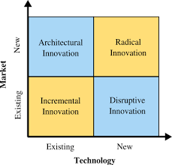
Marketing Innovation -Types
Architectural/Sustaining-modify a system’s components for market leadership – desktop copier
Incremental-small improvements –Gillette razors
Radical –major change to an existing system-Apple iPhone
Disruptive-disrupts a market or creates a new one-low cost, efficient…Netflix, Airbnb
Maintain leadership position within a marketplace bringing advances in technology, size/shape, major/minor bringing value to the consumer.
Format, content and design of the information contained is not to be shared without written permission of Linda Feldman- lfeldman7370@gmail.com

Slide 87
Marketing Innovation
Ikea
From mail-order sales to stores globally. Experience in store (café, babysitting) and zero to basic tools for set up.
Netflix
Disruptive –went from dvd mail, to vending machines to streaming
Quality content, ease of use, Steaming service and distribution based on knowing consumer viewing behavior.
Dyson
Efficiency
“Having an idea for doing something better and making it happen-even though it appears impossible. That’s still my dream.”
James Dyson
Engineer
Format, content and design of the information contained is not to be shared without written permission of Linda Feldman- lfeldman7370@gmail.com

Slide 88
Marketing Innovation
How: Think Design to Market Process
Explore consumer and technological opportunities and constraints
Generate innovation ideas
Consumer insights
Solve a problem or annoyance
Design concepts
Manage the project portfolio to ensure delivery of business objectives
Key Organizational Players;
Marketing
R&D
Procurement
Operations – Supply Chain
Finance
Legal
Sales
Format, content and design of the information contained is not to be shared without written permission of Linda Feldman- lfeldman7370@gmail.com

Slide 89
- Become a Part of The Jewish Entrepreneur To Become a Mentor Email Robert Safren at robert@tjenetwork.com To Get Mentored, click on “Get a Mentor” on our website and fill out the form: tjenetwork.com

Slide 90
Awareness

Slide 91
Awareness = Marketing
Marketing is the process of creating awareness and promoting a business or brand’s products or services to a target audience.
Marketing focuses on utilizing data of target customer markets and developing strategies to reach the target market.
Format, content and design of the information contained is not to be shared without written permission of Linda Feldman- lfeldman7370@gmail.com

Slide 92
Awareness = Marketing
In every case, marketing’s purpose is to create visibility and awareness to potential customers who will then have an interest in the product and act by trial, purchase and hopefully becoming a brand or product ambassador as a regular user and tells others about the product.
Consumers will seek you out as a brand and then further as a company
Format, content and design of the information contained is not to be shared without written permission of Linda Feldman- lfeldman7370@gmail.com

Slide 93
Awareness = Marketing
Successful marketing programs are well planned and aimed at the target market/key user.
That includes development of marketing strategies and planning that resonates with the target market
and utilizing a communication plan within the marketing strategic plan, whether it is a robust website,
advertising digitally or through other channels to grow awareness to translate into purchases.
Strategic Marketing Plan includes the Communication Plan within it
Format, content and design of the information contained is not to be shared without written permission of Linda Feldman- lfeldman7370@gmail.com

Slide 94
AWARENESS
Awareness is created through Marketing efforts to boost brand awareness and build consumer engagement and loyalty
Tactics used to create awareness and recognition based on where its selling
Inbound/Outbound Marketing
In-store merchandising, cross-merchandising, review current competitive assortment
Packaging;
Size, shape, color (Coca-Cola)
Product labeling
Logo
Features/benefits
Utilize Point of Difference to create customer value and drive a competitive advantage
Social Media
SEO, Endorsements, Influencers…
Create a custom hashtag for Instagram
Post regularly to social media, Blogs
Participate in or sponsor local events
Format, content and design of the information contained is not to be shared without written permission of Linda Feldman- lfeldman7370@gmail.com

Slide 95
AWARENESS
Volume
Amount of something; # of sales during an ad campaign
Reach & Exposure
Reach is the potential audience for a message –the number who might see it
Example: a post based on total count of followers or likes
Exposure is the actual number exposed
Super Bowl has viewers 112mil –that’s a huge amount of exposure for those ads
Format, content and design of the information contained is not to be shared without written permission of Linda Feldman- lfeldman7370@gmail.com

Slide 96
AWARENESS
Impressions – the number of times the content is displayed – clicked or not, ads running, picked up by other sources
Engagement – user behavior and actions, time on site, retweets, comments, reply’s, number of participants, frequency of participation and in what form
Amplification – message reaching a wider audience -how far your message spreads; links. Word of mouth, likes, blogs…
Referral programs-added perk…swag
Contests – photo using product/experience
Format, content and design of the information contained is not to be shared without written permission of Linda Feldman- lfeldman7370@gmail.com

Slide 97
BRAND AWARENESS vs RECOGNITION
Recognition
Consumers identify your brand based on visual indicators; logos, color, size/shape
Nike, Starbucks, Target, Dunkin Donuts, Kleenex
Awareness
Knowing and recalling a business name, emotional feel, experience
A mindset
Branding Importance
Customer recognition
Customer Loyalty
Credibility & Trust
Confidence
Consistency
Brand Equity
Shared Values
Experience
Format, content and design of the information contained is not to be shared without written permission of Linda Feldman- lfeldman7370@gmail.com

Slide 98
BRAND AWARENESS vs RECOGNITION
It’s Important because…
Promote your business across multiple channels
Ease to successfully introduce new products or services
Create a brand community-connecting to consumer segments
Reinforce and continue to build a strong reputation
Attract and retain loyal customers
Format, content and design of the information contained is not to be shared without written permission of Linda Feldman- lfeldman7370@gmail.com

Slide 99
- Become a Part of The Jewish Entrepreneur To Become a Mentor Email Robert Safren at robert@tjenetwork.com To Get Mentored, click on “Get a Mentor” on our website and fill out the form: tjenetwork.com

Slide 100
Digital Marketing vs Social Media
?????????????

Slide 101
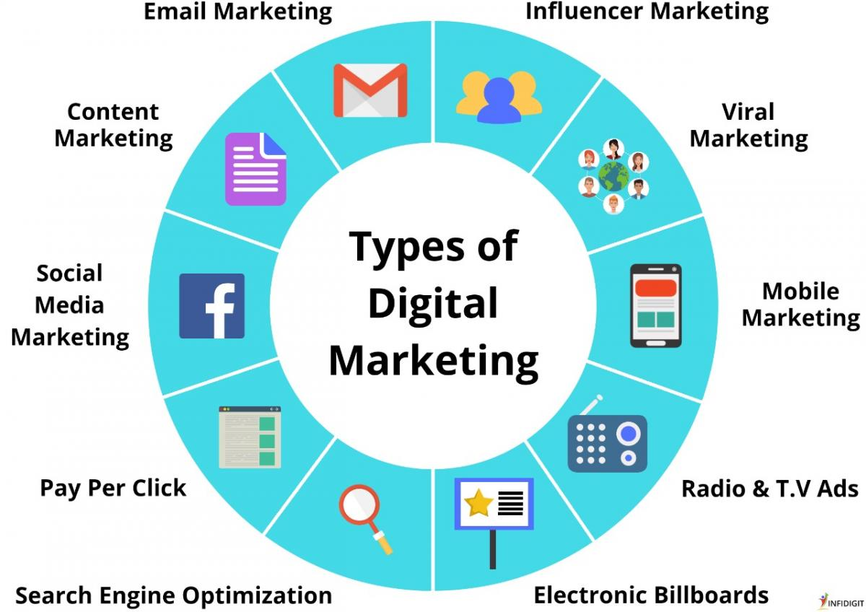
Confused??
Format, content and design of the information contained is not to be shared without written permission of Linda Feldman- lfeldman7370@gmail.com

Slide 102
Confused??
BAM!
Format, content and design of the information contained is not to be shared without written permission of Linda Feldman- lfeldman7370@gmail.com

Slide 103
Digital Marketing is in both Outbound & Inbound Marketing
Website
SEO
Links
Social Media Platforms
Blogs
Viral
Streaming
Influencers
And more…
Format, content and design of the information contained is not to be shared without written permission of Linda Feldman- lfeldman7370@gmail.com

Slide 104
Digital Marketing vs Social Media
Digital Marketing = umbrella term for all types of on-line & electronic marketing activities.
Search Engine Optimization (SEO) –rank higher in Google search to increase traffic to company website
Pay per Click (PPC) –ads and promoted search results and usually drives to a company website whereby the company pays when clicked. Unseen by users.
Social Media-across platforms, consistent content/messaging strategic to create awareness and purchase from target markets.
Content Marketing-strategic messaging of story/information to increase awareness; blogs, articles, podcasts, videos providing value
Format, content and design of the information contained is not to be shared without written permission of Linda Feldman

Slide 105
Digital Marketing vs Social Media
Digital Marketing = umbrella term for all types of on-line & electronic marketing activities.
Email Marketing-direct into the in-box with the goal to be opened and acted upon quickly; email copy is critical, personalization and engagement of recipient where they can set preferences and click through
Mobile Marketing- using text messages, social media, websites, email, and mobile apps via smart phones and tablets –offering unique offers, track locations or merely providing awareness and information for when people shop in store and/or on-line.
Radio, TV & Electronic Billboards- historically, traditional tools. Should be consistent message with other vehicles.
Analytics are easy to obtain making the ROI visible and accurate.
Format, content and design of the information contained is not to be shared without written permission of Linda Feldman

Slide 106
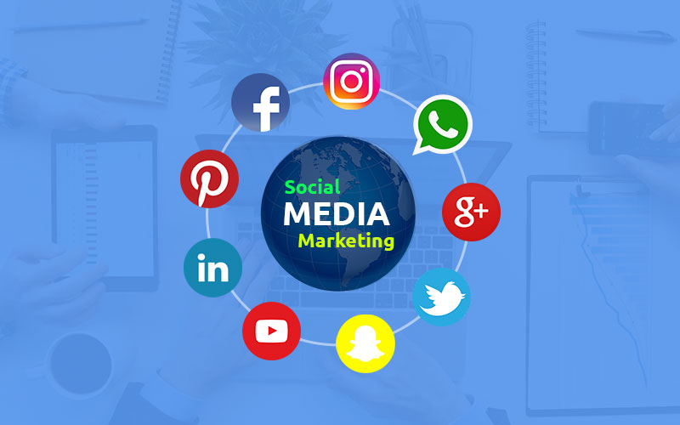
Digital Marketing vs Social Media
Social Media Marketing
Social media marketing is one aspect of digital marketing specific to social media platforms and uses content placed on social media platforms.
It provides the ability to interact with your target market in a high impact, yet low-cost method.
Consistency in messaging is critical.
Some popular social media platforms are;
Facebook. LinkedIn. YouTube.
WhatsApp. Instagram. Pinterest.
Twitter. TikTok. Reddit.
Format, content and design of the information contained is not to be shared without written permission of Linda Feldman- lfeldman7370@gmail.com

Slide 107
Social Media
Social Media = use of on-line content to drive sales/awareness
Content is your message; content can be used strategically to achieve business goals.
it should be relevant & helpful and give customers what they are looking for, especially while they are actively searching for it.
Best content helps to bring customers closer to the purchase, build the relationship, engage users, creates awareness & builds credibility.
Websites; Your business’ site, competitors, adjacencies/others
Format, content and design of the information contained is not to be shared without written permission of Linda Feldman- lfeldman7370@gmail.com

Slide 108
Social Media …Let’s Get Started
Before you think about Posts, Tweets, Blogs, Facebook, Twitter, Instagram, Snapchat……
Social Media is a part of the larger, comprehensive Marketing Plan, within your Strategic Plan
Think: A room within a house
Social Media is an umbrella term recognizing different on-line vehicles, used to reach customers through a variety of methods, using Content as the key component to drive sales/awareness.
Social Media Marketing = one aspect of digital marketing specific to social media platforms
Facebook, Twitter, Snapchat, LinkedIn, Tumblr, Pinterest, YouTube, Instagram, etc.
Content is your message!
Social Media = use of on-line content to drive sales/awareness
Format, content and design of the information contained is not to be shared without written permission of Linda Feldman- lfeldman7370@gmail.com

Slide 109
Don’t forget…..Key Marketing Components
Find & drive relevancy within the marketplace
Meaningful to your customer base-fill a need
Set a consistent Message & Tone and even communication style
Humor, fun, unique identity/personality
Resonate with customer
Identify communication methods to create awareness
Find them where they are so that they can find you
Translate awareness into action > interest, trial/purchase
Be engaging with relevant content to drive customers to your website, store, location
Use data to; Measure the Return on Investment (ROI), Pivot tactics as needed
Format, content and design of the information contained is not to be shared without written permission of Linda Feldman- lfeldman7370@gmail.com

Slide 110
- Become a Part of The Jewish Entrepreneur To Become a Mentor Email Robert Safren at robert@tjenetwork.com To Get Mentored, click on “Get a Mentor” on our website and fill out the form: tjenetwork.com

Slide 111
SOCIAL MEDIA SEO, Content, Metrics
What You need to know -Part I

Slide 112
The marketing world is dynamic and ever-changing
— trends, technology, and tactics are never stagnant.
Format, content and design of the information contained is not to be shared without written permission of Linda Feldman- lfeldman7370@gmail.com

Slide 113
Social Media …Let’s Get Started
Before you think about Posts, Tweets, Blogs, Facebook, Twitter, Instagram, Snapchat……
Social Media is a part of the larger, comprehensive Marketing Plan, within your Strategic Plan
Think: A room within a house
Social Media is an umbrella term recognizing different on-line vehicles, used to reach customers through a variety of methods, using Content as the key component to drive sales/awareness.
Social Media Marketing = one aspect of digital marketing specific to social media platforms
Facebook, Twitter, Snapchat, LinkedIn, Tumblr, Pinterest, YouTube, Instagram, etc.
Content is your message!
Social Media = use of on-line content to drive sales/awareness
Format, content and design of the information contained is not to be shared without written permission of Linda Feldman- lfeldman7370@gmail.com

Slide 114
Social Media
Social Media = use of on-line content to drive sales/awareness
Content is your message; content can be used strategically to achieve business goals.
it should be relevant & helpful and give customers what they are looking for, especially while they are actively searching for it.
Best content helps to bring customers closer to the purchase, build the relationship, engage users, creates awareness & builds credibility.
Websites; Your business’ site, competitors, adjacencies/others
Format, content and design of the information contained is not to be shared without written permission of Linda Feldman- lfeldman7370@gmail.com

Slide 115
Social Media
Social Media = use of on-line content to drive sales/awareness
Search Engine Optimization (SEO) – allows you to understand how consumers are searching and finding information about your brand and your competitors online.
People search key words; Google, Yahoo, Bing =search engines
Youtube 1.4b
Facebook 1.1b
Whatsapp.web 618m
Homedepot 68m
Costco 40m
Format, content and design of the information contained is not to be shared without written permission of Linda Feldman- lfeldman7370@gmail.com

Slide 116
Social Media
Social Media = use of on-line content to drive sales/awareness
SEO strategies can be part of your marketing efforts
help to increase your websites’ visibility and rankings
translate into increasing website traffic and ultimately conversions /sales
SEO employs the use of content that is created with the goal of attracting search engine traffic
Google, Yahoo!, Bing, etc.
Content gets picked up in searches and boosts website traffic
LSI/KeySearch word development (latent semantic indexing) key search words and phrases
Format, content and design of the information contained is not to be shared without written permission of Linda Feldman- lfeldman7370@gmail.com

Slide 117
Social Media traffic
Using keywords to drive traffic
First-make sure that your webpage is relevant and targeted to the keywords that you want to rank for.
This will ensure that you get visitors from search engines.
You should also check your current website ranking for the targeted keywords.
If you don't rank in the top 10 of Google, then the chances of getting ranked significantly are almost impossible
So, what! – if you have key words associated with your industry or your product/service then you can still gain traction – be general and specific
See what your competitor's webpage is doing
You can use the same or similar keywords and see how they are used in their webpage.
This will tell you if they are targeting those keywords effectively or not.
Format, content and design of the information contained is not to be shared without written permission of Linda Feldman- lfeldman7370@gmail.com

Slide 118
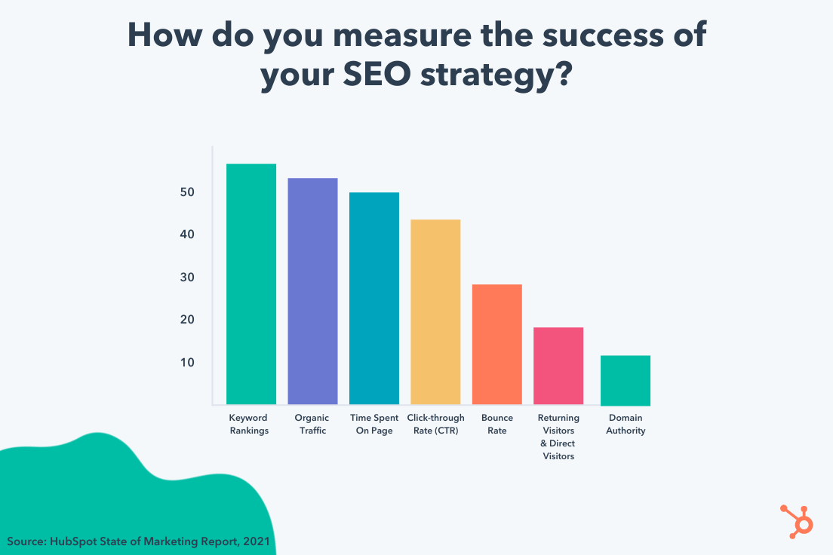
Social Media
Format, content and design of the information contained is not to be shared without written permission of Linda Feldman- lfeldman7370@gmail.com

Slide 119
Social Media traffic
Keyword Ranking –keyword search- terms that users enter search engines when looking for products, services or general information
Organic Traffic- website visitors that ‘land’ on your website via unpaid sources (search engines based on a keyword-SEO brings them to you), awareness, word of mouth, repeat.
Time Spent on Page- track pageview hits, how many pages someone views within your site –their navigation – time from when they land on a page and stay there – Google analytics provide this data –landing page report
Format, content and design of the information contained is not to be shared without written permission of Linda Feldman- lfeldman7370@gmail.com

Slide 120
Social Media traffic
Click-Through Rate (CTR)- gauge how your keywords, ads and free listings perform the number of clicks divided by the number of times the ad is shown (impressions)
If you had 5 clicks and 100 impressions = CTR of 5%
Click through rate for search of 1.91% is good
Bounce Rate- % of visitors that enter the site, then leave
Not moving page to page within the site
Format, content and design of the information contained is not to be shared without written permission of Linda Feldman- lfeldman7370@gmail.com

Slide 121
Social Media traffic
Return Visitors & Direct Visitors-
Google analytics tracks return visitors
These visitors are interested, they can be or become loyal
Marketing efforts bring them in
Domain Authority- search engine ranking score
Tells you how successful the search engine results are
Format, content and design of the information contained is not to be shared without written permission of Linda Feldman- lfeldman7370@gmail.com

Slide 122
Social Media
Social Media = use of on-line content to drive sales/awareness
Channels;
Facebook, Twitter, Snapchat, LinkedIn, Tumblr, Pinterest, YouTube, Instagram, etc.
Ads, Posts, Links, Articles
Channel to use depends on the type of information, audience to reach and tools that they use
Media; Blog, Influencers (Often paid)
Tactic; Twitter party-unique hashtag, influential twitterer, photos, to pose questions and lead the conversation with goal to create awareness, measure the chat effectiveness, get to know the community
*Continuous development and transformative change (including legalities) in digital marketing and media can impact your digital strategy
Format, content and design of the information contained is not to be shared without written permission of Linda Feldman- lfeldman7370@gmail.com

Slide 123
AWARENESS
Volume –amount of something; # of sales during an ad campaign
Reach & Exposure
Reach is the potential audience for a message –the number who might see it
Example: a post based on total count of followers or likes
Exposure is the actual number exposed
Super Bowl has viewers 112mil –that’s a huge amount of exposure for those ads
Impressions – the number of times the content is displayed – clicked or not, ads running, picked up by other sources
Engagement – user behavior and actions, time on site, retweets, comments, reply’s, number of participants, frequency of participation and in what form
Amplification – message reaching a wider audience -how far your message spreads; links. Word of mouth, likes, blogs…
Format, content and design of the information contained is not to be shared without written permission of Linda Feldman- lfeldman7370@gmail.com

Slide 124
Social Media Goals
Define your Goals
What actions do you want?
What are you trying to gain or accomplish through social channels?
Which channels are most relevant to the goals?
B2B = LinkedIn vs facebook
Generate a list of goals for social media;
Broadcast Information >reach,exposure
Create Awareness
Answer customer questions
Engage with a community
Set metrics and Measurement Tools
Content analytics informs effective content writing for newsletters, emails, blogs and social media.
Metrics & Behaviors -#’s, Actions
Format, content and design of the information contained is not to be shared without written permission of Linda Feldman- lfeldman7370@gmail.com

Slide 125
Strategic Social Media Plan
The objective for using Social Media is “ACTION”
You want to get people to do something…
Usually ending with becoming a customer by purchasing and using your product/service over and over
It can also be to read, signup -newsletter, reply, repost, click, share, visit your website
Drive Traffic to your website
It starts with understanding your product/service, competition, vision statement, mission statement, etc.
Format, content and design of the information contained is not to be shared without written permission of Linda Feldman- lfeldman7370@gmail.com

Slide 126
Strategic Social Media Plan
The Strategic Social Media Plan becomes tactical
Many components must be in place for best results;
Understand your customer, and their needs
Content Planning – Content Marketing
Consumer insights of the Target Market on-line activity; specific questions of product/services
Informative, helpful
Frequency, Placement
SEO & Website; Technical & Design
Technical
Design
Format, content and design of the information contained is not to be shared without written permission of Linda Feldman- lfeldman7370@gmail.com

Slide 127
Content Strategy - Plan
Content strategy is critical to having a voice that is heard
Control the sales conversion through content development
To be impactful, it must be Relevant
Create relevant content for a website – start to finish
Build your content strategic plan that will;
Align with trending topics (use key search words)
Write with brand tone, voice
Optimization; key search words with landing pages,
Publishing; articles, blogs, posts, infographics, videos (that contain the key search words)
Anticipate consumer questions
Drive action from your landing page
Drive organic growth
Promotion
Format, content and design of the information contained is not to be shared without written permission of Linda Feldman- lfeldman7370@gmail.com

Slide 128
Content Strategy - Plan
Content Plan – Steps
Gather Information
Target demographics
Key competitors
Google analytics; past website performance
Website audit; technological; on-site & off-site including page speed, connections, backlinks, building links, roadmaps, URLS, domain, hosting
Website goals
Competition
Unique client information
Data
Determine fixes needed & implement
Format, content and design of the information contained is not to be shared without written permission of Linda Feldman- lfeldman7370@gmail.com

Slide 129
SEO & Website; Technical & Design
To begin Social Media Program;
Website must be technically robust
Technical;
Landing pages, links, link building structure, robust links/files, see who has backlinks to your site, sitemaps-advise search engines of content, defined anchors, quality backlinks, speed, id top google keywords for your type of product use google analytics,, analytics of cold mail
Identify and fix technical issues that may exist with your site;
Guide traffic, robust files, FAQ’s for Google HGML standards to drive traffic & adjust as needed, blog link building,…
Product landing page -content aligned to consumer behavior
Content –relevancy, quality, build trust, guide visitors to act
SEO –LSI’s, Searchwords, Phrases, Clusters, Competitors, Back links…
eCommerce capability-sell direct and process payment
FAQ’s –helpful answers -customer service input, includes Searchwords, Tips
Format, content and design of the information contained is not to be shared without written permission of Linda Feldman- lfeldman7370@gmail.com

Slide 130
SEO & Website; Technical & Design
To begin Social Media Program;
Website must have an easy to navigate and sensible design
Design;
Website – customer experience touch point – must be intuitive, pleasant, tone, ease of use, consistency, colors, functionality, optimized for mobile, credibility through testimonials/reviews, Photos &Video for back story and connect to user on a personal level, feedback loop after purchase cycle, internal search is easy to use and works with keywords and attributes, make it easy for users to communicate back to you contact us also include phone, email, etc.
Content should be organized and logical and easy to navigate
Product landing page -content aligned to consumer behavior
Content –relevancy, quality, build trust, guide visitors to act
SEO –LSI’s, Searchwords, Phrases, Clusters, Competitors, Back links…
FAQ’s –helpful answers -customer service input, includes Searchwords, Tips
Format, content and design of the information contained is not to be shared without written permission of Linda Feldman- lfeldman7370@gmail.com

Slide 131
Search Engine Optimization (SEO)
Drive traffic to your website
Get noticed and out of the pack
Keyword research
Find competitors and see what they are doing (critical to get their info & data)
Page optimization – each searchword should have a landing page on your site
List extensive LSI (latent semantic indexing) key searchwords and phrases, then cluster
Research keywords before developing content-focus on keywords that have existing search word volume
Write content for things people are already searching for
Structure & create landing page for each/all
Title & link page for each/all
Double-check relevant key words and change title on web page as needed
Format, content and design of the information contained is not to be shared without written permission of Linda Feldman- lfeldman7370@gmail.com

Slide 132
Search Engine Optimization (SEO)
FAQ’s- aligned to keywords and helpful
Backlinks- to others’ sites, see who links to yours, keep updating monthly
Write blogs, articles (aligned with relevancy & keywords), post and see results to drive traffic
Blog link building
2-3 articles monthly – contain key words, be relevant, be helpful, publish
Format, content and design of the information contained is not to be shared without written permission of Linda Feldman- lfeldman7370@gmail.com

Slide 133
- Become a Part of The Jewish Entrepreneur To Become a Mentor Email Robert Safren at robert@tjenetwork.com To Get Mentored, click on “Get a Mentor” on our website and fill out the form: tjenetwork.com

Slide 134
SOCIAL MEDIA SEO, Content, Metrics
What You need to know -Part II

Slide 135
Social Media = Action
Format, content and design of the information contained is not to be shared without written permission of Linda Feldman- lfeldman7370@gmail.com

Slide 136
Content Strategy - Plan
Blogs drive sales
Other companies, organizations in the field may like your content and link to you
Links are seen by Google as endorsements by other websites
External endorsements are valuable
Over time, links add value, improves rankings an that is optimizing the search engine
Format, content and design of the information contained is not to be shared without written permission of Linda Feldman- lfeldman7370@gmail.com

Slide 137
Content Strategy - Plan
Strategize
Build out the content strategy and editorial calendar for blogs, articles, etc.
Write two or more 2,000-word articles each month
Look for keywords that received 50+ searches in 1 month and have an Ahrefs difficulty score of 0-10
You can narrow blog searches to 100 searches a month & 0-5 difficulty score
Goal is to have a good search volume and low competition
Start with these topics & build your backlink profile and domain authority
Best to have a link building strategy to maximize impact of content
Ahref; analyze backlink profile, SEO health, keyword research tool, Finds content that has performed well (shares/links)
Format, content and design of the information contained is not to be shared without written permission of Linda Feldman- lfeldman7370@gmail.com

Slide 138
Content Strategy - Plan
Blog Topic Analysis
Review competitors' performance
What pages on their sites drive traffic – how do they drive traffic?
What’s their backlink profile
Length & quality of those pages
See if you can outrank the competition; Ahrefs sitebalance.com tool to see page performance # of words for top content, # of domain links
Solution centric key word search
Indirect competitor topic analysis
Quora topic analysis
Build content
Build a list of keywords and phrases to use in relevant articles – put into spreadsheet & analyze assign a keyword score
Format, content and design of the information contained is not to be shared without written permission of Linda Feldman- lfeldman7370@gmail.com

Slide 139
Content Strategy - Plan
Write
Write articles that people will read based on the content – that they enjoy
Articles that they enjoy so much and want to share
Then drop in the key search words 2-3 times
Articles should answer questions customers may have then they may go to your site
Put a call to action in the article i.e. sign up for a newsletter, to promote future content via email marketing
Optimize & Publish
SEO = Search Engine Optimization
Important factors; readability, word count, related keywords, all to make the content attractive to search engines and readers
Need title tags, title pages – for each keyword and meta descriptions to increase click through rates
Format, content and design of the information contained is not to be shared without written permission of Linda Feldman- lfeldman7370@gmail.com

Slide 140
Content Strategy - Plan
Promote
Quality content – use social media, email, all over
Republishing platforms
Goal is visibility
Use backlinks
Review & Repeat
Continuous process- constantly evolving
Monthly reviews’ Stay on tack or pivot based on data
Pivot with new content development if the current content does not resonate – use measure tools to see if it resonates through clicks, links, actions
See what works and what doesn’t
Create valuable content & experiences tailored to your customer
Format, content and design of the information contained is not to be shared without written permission of Linda Feldman- lfeldman7370@gmail.com

Slide 141
Content Strategy - Plan
Fast Way to Scale
ROI of SEO
Gain a top spot when people search Google
Exact phrase
Key words
See what ranks top on Google searches
Make it easy for Google to understand what you do
Get other websites to link back to your website
Backlinks!
Each link to your blog articles boosts your authority of that article
Raises your search rank, boosts overall on-line presence
Format, content and design of the information contained is not to be shared without written permission of Linda Feldman- lfeldman7370@gmail.com

Slide 142
Measure It!
Why Measure your social media? Or any marketing or advertising?
You want to know the impact of your marketing dollars
You want to know the impact of the awareness and actions created by your efforts
You want to understand the impact of the specific spend in each area
Know what is working and what is not working
Correlation to Sales
Format, content and design of the information contained is not to be shared without written permission of Linda Feldman- lfeldman7370@gmail.com

Slide 143
Measure- Social Media
Increase in Followers-seeing a rise in the follower base clearly means that you are marketing your business right
Reactions to your Post-The likes, comments and the way users react to your business posts is a sign of your success
Find out Reach-The more people you manage to reach on social media, the better your campaigns are
Referral Traffic-Take into account referral traffic when you are measuring the success of your social media campaign
Examine Click-Through Rates-The higher your click-through rate is, the more visitors will be drawn to your website
Format, content and design of the information contained is not to be shared without written permission of Linda Feldman- lfeldman7370@gmail.com

Slide 144
Social Media Metrics
How to measure social media campaigns;
Ongoing Analytics – track activity over time
Campaign-focused metrics-event analysis with a beginning and end
Twitter Party example; Tweet volume & reach of the chat, # of people that tweeted the hashtag, Community; influence follower counts, Klout scores, Demographics
Track your brand/product/service to have a finger on the pulse of the general conversation about your brand/company
Understand the impact of targeted marketing initiatives
Each one can vary depending on goals
Tracking both is most effective
Format, content and design of the information contained is not to be shared without written permission of Linda Feldman- lfeldman7370@gmail.com

Slide 145
Social Media Metrics
Define objectives/goals of organic traffic growth, KPI’s, Channel performance, etc. then build tactical measurement and tracking tools
Utilize channel measurement tools, when possible, use a 3rd Part or build with API’s (Application Programming Interface) computing software to define interactions between multiple software.
Have measurement tools in place prior to campaigns
Filter out spam when possible
Monitor monthly
Monitor & report – set a baseline or benchmark
4-12 months impact
Compare data, Adjust & repeat, Pivot and modify
Track competitors when possible and measure against your numbers
Test new ideas; control & variable
Format, content and design of the information contained is not to be shared without written permission of Linda Feldman- lfeldman7370@gmail.com

Slide 146
Social Media Metrics
What to measure social media campaigns;
TRAFFIC
Website activity
Mobile site and social media activity
Connecting with your target market
Use the data to make inform decisions
Identify changes promo period
See what resonates
Id best channels
Evaluate engagement
Google analytics dashboard; percentage, performance, compare, etc
Format, content and design of the information contained is not to be shared without written permission of Linda Feldman- lfeldman7370@gmail.com

Slide 147
Social Media Metrics
What to measure social media campaigns
TRAFFIC
Track URL, shares, click-through-rate, bounce rate, conversions & conversion rate
Ensure your website keeps the traffic flowing
Are people moving through social media to your site, what do they do once on your site
Referral Traffic, Backlinks,
Find Advocates & Fans; track contributors, influencers, who is participating and what is their impact? Twitter chat, volume & reach of the chat, follower count, Klout scores-counts the value of participation
Format, content and design of the information contained is not to be shared without written permission of Linda Feldman- lfeldman7370@gmail.com

Slide 148
Social Media Metrics
Awareness is a term used across all Marketing efforts to refer to
Tactics to create awareness based on where its selling
In-store merchandising, cross-merchandising, review current competitive assortment,
Packaging; features/benefits
utilize Point of Difference to create customer value and drive a competitive advantage
Social Media; explain the types/platforms
SEO, Blogs, Endorsements…
Format, content and design of the information contained is not to be shared without written permission of Linda Feldman- lfeldman7370@gmail.com

Slide 149
Social Media Metrics
Reach & Impressions
Reach & Exposure
Reach is the potential audience for a message –the number who might see it
Example: a post based on total count of followers or likes
Exposure is the actual number exposed
Super Bowl has viewers 112mil –that’s a huge amount of exposure for those ads
Impressions – the number of times the content is displayed – clicked or not, ads running, picked up by other sources
Engagement – user behavior and actions, time on site, retweets, comments, reply’s, number of participants, frequency of participation and in what form
Amplification – message reaching a wider audience -how far your message spreads; links. Word of mouth, likes, blogs…
Format, content and design of the information contained is not to be shared without written permission of Linda Feldman- lfeldman7370@gmail.com

Slide 150
Social Media Reach
Format, content and design of the information contained is not to be shared without written permission of Linda Feldman- lfeldman7370@gmail.com

Slide 151
Social Media Metrics
Engagement - ACTIONS
Read
Share
Like
Sign up
Purchase
Reply
Clicks
Comment
Format, content and design of the information contained is not to be shared without written permission of Linda Feldman- lfeldman7370@gmail.com

Slide 152
Social Media Metrics
Amplification
The rate that your followers share your content through their networks
(ratio of shares/per post)
Creates exposure to new audiences' active choice by followers to tie to your brand – they can become brand ambassadors
How to measure amplification rate:
# of times posts are shared or re-posted, divide by your # of total followers, then multiply by 100
Facebook metrics; conversation, amplification, applause (FB ROI)
Conversation rate = # of comments per post (endorsements)
Applause rate= # of likes per post
Path to sales = economic value
Sum of short & long term revenue and cost savings
Format, content and design of the information contained is not to be shared without written permission of Linda Feldman- lfeldman7370@gmail.com

Slide 153
Social Media Metrics
Social Media Referrals -Referral Traffic
Visitors coming to your site from social media
Brand experience begins – interested in your content & offerings
Goal: Keep them on the site
Instagram story, video ad, website call to action
Tell them what to do next; shop, sign up, watch, try, start
Call to actions- use specific action words
Track who is interested in your content
Know what content resonates & leverage that to improve your social strategy
Measure social referrals through Google analytics – see who drives traffic to your site
Google analytics; Set up landing pages, pixels, goal conversions for data. Visits, conversions, goal conversions rates per visit goals from sources, visit goals referrals from Facebook – Factivate spreadsheet
Format, content and design of the information contained is not to be shared without written permission of Linda Feldman- lfeldman7370@gmail.com

Slide 154
Social Media Metrics
Click-Through-Rate (CTR)
How many people click ad or content
Typically directed to a landing page on your site for additional content.
Search words drive this search to get them to your site through links, in content of ads also
Low CTR then content is not resonating
CTR can affect ad costs
Social platforms favor ads with high click through rates
They get more impressions & better placement
Rewarded with lower costs per click
CTR Measure = # of clicks divided by number of impressions x 100
All social media platforms measure this automatically
Format, content and design of the information contained is not to be shared without written permission of Linda Feldman- lfeldman7370@gmail.com

Slide 155
Social Media Metrics
Bounce Rate
Low bounce rate is preferred= Keep user engaged on your site
Compare bounce rate from different traffic sources;
Facebook, Bing – to identify which channel is most effective and further establish your social strategy
Google analytics measures bounce rates
(acquisition tab, all traffic, segment by channels-bounce rate column)
Format, content and design of the information contained is not to be shared without written permission of Linda Feldman- lfeldman7370@gmail.com

Slide 156
Social Media Metrics
Conversions & Conversion Rate
Define what you want it to be;
Direct website purchase or newsletter subscription, register for an event, etc. – what action?
Business goals that will raise your bottom line
How many people will click your ad & buy
It is a direct effect on your ROI
For an ad to be worthwhile – strong conversion rate & low cost per conversion
Track Users path through a shortened URL or call to action link that is collecting data
This allows tracking of which organic social media posts are leading to conversions
Format, content and design of the information contained is not to be shared without written permission of Linda Feldman- lfeldman7370@gmail.com

Slide 157
Social Media Metrics
Cost Per Conversion (or cost per action)
Cost per click & number of clicks for a conversion – per click cost must be lower than cost of goods for a profit
Track most critical social media metrics effectively – use the data to make real changes that impact your business
Format, content and design of the information contained is not to be shared without written permission of Linda Feldman- lfeldman7370@gmail.com

Slide 158
Social Media Metrics
Format, content and design of the information contained is not to be shared without written permission of Linda Feldman- lfeldman7370@gmail.com

Slide 159
Tools Glossary
Quora; Q&A website
Ahref; analyze backlink profile, SEO health, keyword research tool, Finds content that has performed well (shares/links)
TF-IDF; helps Google identify if you cover all relevant topics in your content. Statistical measure that evaluates word relevancy to a document or documents
Publishing Platforms; digital publishing software platforms to publish content online as an app, create content on line & generate traffic. Transition from print & PDF formats to mobile friendly reading experiences
Skag Approach; Single keyword ad group
Spark Toro; find sites, blogs, podcasts, social accounts, publications that reach your audience
Google analytics; track and report website traffic, usage data
Social Media analytics provides data on competitors
Hootsuite; Track data
Go Daddy, Host gator; example of large hosting companies – many others also host and even companies that set up websites handle hosting on a monthly rate. Smaller companies host may be safer
MOZ – SEO guide to on-page optimization
Format, content and design of the information contained is not to be shared without written permission of Linda Feldman- lfeldman7370@gmail.com

Slide 160
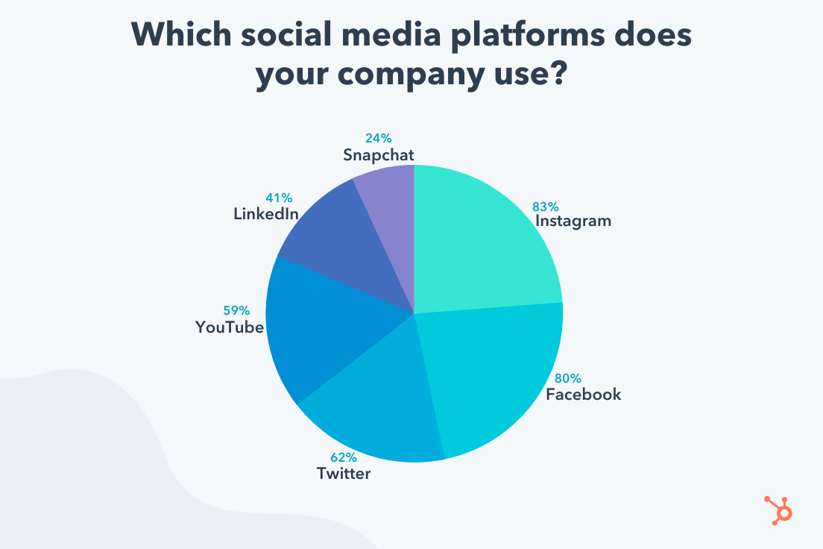
Social Media Metrics
Source: HubSpot
Format, content and design of the information contained is not to be shared without written permission of Linda Feldman- lfeldman7370@gmail.com

Slide 161
SEO & SOCIAL MEDIA
Now You know

Slide 162
- Become a Part of The Jewish Entrepreneur To Become a Mentor Email Robert Safren at robert@tjenetwork.com To Get Mentored, click on “Get a Mentor” on our website and fill out the form: tjenetwork.com

Slide 163
Marketing Tools & tactics

Slide 164
Marketing Tools & Tactics
Types of Marketing Tools
How do you get your business’s message in front of prospects, inform them of your business, and convert them into customers
Offline and traditional.
Digital and online.
Face-to-face.
Cross-category.
Consider cross-over between any of these categories for most effective results
There are no rules to which you must/should use…. Go where your customer is –use the insights
Format, content and design of the information contained is not to be shared without written permission of Linda Feldman- lfeldman7370@gmail.com

Slide 165
Marketing Tools & Tactics
Digital and Online Marketing Tools
Digital marketing =umbrella term that refers to all types of marketing involving electronic media.
Smartphone apps, television, and podcasts are all types of digital marketing.
Online marketing is a subset of digital marketing
Specific to content delivered via the internet such as websites, social media, and other forms of content marketing.
Website and Inbound Marketing
Create a professional customer-focused website for your business.
Use online marketing strategies like landing pages, content marketing, and SEO to attract and engage visitors.
Inbound marketing is a term used when businesses drive traffic to their website rather than directly advertising products or services. The website encourages people to interact, for instance by completing a form or survey, and this introduces them to your brand and products.
Format, content and design of the information contained is not to be shared without written permission of Linda Feldman- lfeldman7370@gmail.com

Slide 166
Marketing Tools & Tactics
SEO
SEO = search engine optimization, a marketing technique that focuses on using keywords relevant to your products or services.
People conducting online searches will be led to your website by search engines based on the keywords you use in your website content.
Optimizing your content to improve your ranking on search engines.
Internet users conduct millions of searches every day
SEO is one of the primary ways to drive traffic to your website.
Email Marketing
Email marketing = sending messages to a list of subscribers who have agreed to receive email from your business.
Easy method for communicating with a large audience & low cost
Provide valuable information, free materials, helpful tips, not only ads or marketing messages
Convenient and fast, making it easy to keep contacts informed of business activities, special offers, and other relevant information
Format, content and design of the information contained is not to be shared without written permission of Linda Feldman- lfeldman7370@gmail.com

Slide 167
Marketing Tools & Tactics
Content Marketing
Using a strong and consistent message across various platforms with the goal of creating awareness that eventually turns into purchase.
When others share your content, it is a form of endorsement/support/trust and can attract and engage large numbers of your target market.
Tactics for content marketing include:
Blog posts. All social media –SEO searches
Podcasts.
Videos and live streams.
Webinars.
Case studies.
Infographics, gifs, and memes.
Presentations and webinars.
eBooks and PDF documents.
Testimonials. Quizzes, surveys, and contests.
Interviews.
Website. FAQ pages.
Newsletters.
Format, content and design of the information contained is not to be shared without written permission of Linda Feldman- lfeldman7370@gmail.com

Slide 168
Marketing Tools & Tactics
Face-to-Face Marketing Strategies
Face-to-face marketing strategies -develop genuine connections with prospects.
For small businesses, face-to-face marketing can be one of your most effective types of marketing.
Build your brand by creating and nurturing relationships with both prospects and other professionals.
Networking
Networking allows you to develop personal relationships and creating connections.
Good interpersonal skills and creating an intentional, structured networking plan can bring a major impact
Join professional organizations, chambers of commerce, or specific networking organizations.
Strengthen your network by becoming a business connector, a person who knows many people and enjoys making introductions and otherwise helping others in their circle
Format, content and design of the information contained is not to be shared without written permission of Linda Feldman- lfeldman7370@gmail.com

Slide 169
Marketing Tools & Tactics
Mobile Marketing
Mobile marketing – marketing to the target consumer through their mobile devices utilizing email, SMS, applications (apps), websites, and social media through the vehicles of mobile devices i.e. smartphones or tablets.
Advantageous being in-hand of the customer while they may be in the purchase mindset or investigation.
A key factor is the ability to provide product information, location, price, features/benefits quickly and accurately.
SMS Marketing
SMS marketing is mobile marketing where people opt-in and agree to receive text messages (SMS) from your company.
Used to share time-sensitive offers or important updates.
Personal to the customer –affordable, ability to adapt messaging to the sender.
Format, content and design of the information contained is not to be shared without written permission of Linda Feldman- lfeldman7370@gmail.com

Slide 170
Marketing Tools & Tactics
Community Involvement
Community involvement is a good visibility tactic for a business, and it benefits the community as well.
Creates a positive local environment and gives your business the chance to interact with the community at a personal level and build a positive reputation.
Consumers are more committed to companies that give back, and a Fortune Magazine poll stated that millennials prefer companies that give back to the community.
Associations and Trade Shows
Attending association and trade shows is a valuable marketing strategy
Exposure, both to prospects and within your industry.
Offers your company the ability to educate prospects on your products at a personal level.
Gives your business networking opportunities.
Conduct market research of the competition, increasing knowledge of your field.
Gives your company the chance to learn about new products, processes, and ideas in the industry.
Provides opportunities for training and development.
Lead generation and sales opportunities.
Format, content and design of the information contained is not to be shared without written permission of Linda Feldman- lfeldman7370@gmail.com

Slide 171
Marketing Tools & Tactics
Attend or Conduct Workshops
Expand your network, improve skills and learning.
Hosting or conducting workshops is a way to demonstrate your expertise and market other products and services to attendees.
Public Speaking
Market your business while demonstrating your expertise to target prospects
Extend your reach into the industry segment, enhance visibility, command expertise
Develop yourself as an industry expert- trade shows, seminars, etc.
Format, content and design of the information contained is not to be shared without written permission of Linda Feldman- lfeldman7370@gmail.com

Slide 172
Marketing Tools & Tactics
Relationship marketing
Building and developing long-term relationships with customer proves to be more valuable to a company over time than only trying to sell them something.
Customers who have a positive relationship with a company tend to purchase more and refer others more frequently.
Some examples of relationship marketing are:
Loyalty, incentive, and referral programs.
Customer-driven content.
Live video streams.
Personalized, customer-focused, responsive customer service.
Feedback — survey and collect feedback.
Format, content and design of the information contained is not to be shared without written permission of Linda Feldman- lfeldman7370@gmail.com

Slide 173
Marketing Tools & Tactics
Affiliate Marketing, Joint Ventures, and Cross-Promotions With Influencers
Partnering up with other businesses gives you each the chance to build your audience and expand your reach.
Affiliate marketing is when a business pays a commission for referrals that generate sales-Influencer
Joint ventures are two or more businesses that join together for a specific promotion and splitting the costs, risks and proceeds-Uber & Volvo
Build a consortium – complimentary – non-competitive to share costs to amplify the reach as well as gain credibility for all
Cross-promotion -team up with another brand to promote each others’ offers or services. Pepsi & Taco Bell
Write It!
A published book builds your authority and credibility by establishing you as the expert.
Blogs are effective to push content and message quickly
Format, content and design of the information contained is not to be shared without written permission of Linda Feldman- lfeldman7370@gmail.com

Slide 174
Marketing Tools & Tactics
Guerilla Marketing
Guerilla marketing -grass-root or unconventional methods that attract attention for a business in order to boost sales.
Low-budget creative techniques that involve large crowds of people and unexpected or unlikely marketing tactics
They are effective because they are distinctive, engaging or amusing, and highly memorable, and generate publicity.
Give free samples, flash mobs, publicity stunts
Alert the media…. Paparazzi know ahead that the celebrity will be there
Format, content and design of the information contained is not to be shared without written permission of Linda Feldman- lfeldman7370@gmail.com

Slide 175
- Become a Part of The Jewish Entrepreneur To Become a Mentor Email Robert Safren at robert@tjenetwork.com To Get Mentored, click on “Get a Mentor” on our website and fill out the form: tjenetwork.com

Slide 176
Key Performance Indicators (KPI’s)

Slide 177
Define & implement KPI’s
Key Performance Indicators (KPI’s) are measurements that you identify as success factors
Use to Track and Measure Your business results.
Typically, it is a set of targets –objectives
Define Goals & Objectives
Beneficial to track and measure the results of your marketing activities.
Identify effective, efficient approaches to measure value and effectiveness of the effort
Invest more into what’s working, eliminate what’s not, or identify areas of improvement.
Format, content and design of the information contained is not to be shared without written permission of Linda Feldman- lfeldman7370@gmail.com

Slide 178
Quantifiable Goals & Objectives
Create Plans to drive your Marketing efforts
Ensure that you have a comprehensive plan that covers the variety of methods to create awareness and uses consumer insight as a key component to know the right message to drive
Example; Update Website – Use SMART goals as a tool
Redesign for ease of use
Update messaging –ensure it is consistent across all media
Ensure site works for mobile
Confirm logo is accurate, ensure diverse photo’s, revise phone number, link to x sites,
S.M.A.R.T. = Specific, Measurable, Actions, Relevant, Time-bound
Format, content and design of the information contained is not to be shared without written permission of Linda Feldman- lfeldman7370@gmail.com

Slide 179
Quantifiable Goals & Objectives
Define what is working and what is not working
Identify what to continue to do or begin to do
Ideas of how to implement and execute
Build into year 1, 2, 3 Planning
Keep track of future ideas 2-3 years (+beyond)
Define future state and develop objectives and strategies to achieve the company vision, implementation and assessment of the Plan
Identify and confirm goals (short term/long term) and requirements to achieve the goals
Format, content and design of the information contained is not to be shared without written permission of Linda Feldman- lfeldman7370@gmail.com

Slide 180
Define & implement KPI’s
Example: Run a Sale item
Did you sell more? Then when not on sale
Did it bring in traffic?
Did it create awareness to the overall company?
Did you sell more of other complimentary items due to this?
Did you have small sales increase but more orders-therefore not enough inventory?
Always measure, track, monitor
Ability to be swift to make modifications if needed to tactics
Define & Implement KPI’s; measure, track, monitor
Format, content and design of the information contained is not to be shared without written permission of Linda Feldman- lfeldman7370@gmail.com

Slide 181
Execution of Annual Plan
Action plan – time based (Short term:12-24 mo/ Long Term:3 -5 yr)
Implementation/Follow up; systematic implementation- S.M.A.R.T., monitor against set milestones, adjust to changing conditions
S.M.A.R.T. = Specific, Measurable, Actions, Relevant, Time-bound
S.M.A.R.T. = Strategic, Measurable, Accountable, Responsible, Time-bound
EXAMPLE
Specific /What | Timeline | Actions | Responsible | Cost | Measure | Comments
Hire AP -2 people | Q1 2022 | Indeed Recruiters F&F | HR Finance | $15k | Track # of good candidates F&F | On track
Build inventory of Product A | 2022-20233 | Mfr. Goods Cost of Goods Procurement Inventory | Supply Chain Finance Marketing | TBD | OTIF Weekly Mfr schedule | Support promotions and regular PO’s
Communication Plan (part of the Marketing Plan) | 2022-2023 | Website update, SEO, Blogs | Marketing Finance | $300k | Build & Launch -8 month Measure Reach Track Spend | Confirm Marketing firm after pitches
Format, content and design of the information contained is not to be shared without written permission of Linda Feldman- lfeldman7370@gmail.com

Slide 182
Execution of Annual Plan
Action plan – time based (Short term:12-24 mo/ Long Term:3 -5 yr)
Implementation/Follow up; systematic implementation- S.M.A.R.T., monitor against set milestones, adjust to changing conditions
S.M.A.R.T. = Specific, Measurable, Achievable, Relevant, Time-bound
S.M.A.R.T. = Strategic, Measurable, Accountable, Responsible, Time-bound
EXAMPLE
What | Timeline | Channels | Key Message | Cost | Success Factor | Comments
Communication Plan | Monthly | Website-content, graphics, eCommerce ability | Look Younger | $100k | -Links brought 20k hits to site -10k hits/50% resulted in purchase | Update graphics 3x annually to stay relevant
 | Q2 & 3 | Print & Influencer | Be smart & Look Younger | $300k $25k | 5 mil impressions, 300k followers | X turned into purchases +$50mil sales
 | Q1-Q4 | Blogs, SEO | Be smart & Look Younger | $10k | Articles linked to other sites, -Traffic to website | Revisit plan every six months
Format, content and design of the information contained is not to be shared without written permission of Linda Feldman- lfeldman7370@gmail.com

Slide 183
- Become a Part of The Jewish Entrepreneur To Become a Mentor Email Robert Safren at robert@tjenetwork.com To Get Mentored, click on “Get a Mentor” on our website and fill out the form: tjenetwork.com

Slide 184
Marketing Budgeting
Know the Numbers

Slide 185
Marketing Budget
Marketing budget
Develop a budget
Allows you to stay focused
Track the spend
Pivot as needed
Identify the Marketing methods that could work
Develop general ideas of frequency and what is involved
Print ad, Blog, Influencer, etc.
Create a view of general costs
Figure out what makes sense to reach your target market
Build a plan based on the what, how and costs
Format, content and design of the information contained is not to be shared without written permission of Linda Feldman- lfeldman7370@gmail.com

Slide 186
Marketing Budget
Marketing budget summary and monthly marketing budget tracker
You must have a view of what the Marketing Spend is in order to understand if it is effective
Effectivity is based on your value of the Marketing tactics, some are not only set in dollar value
Understanding the share of your budget is important in knowing where your money is being spent
Identify and track so that you know which channel is providing better results
See what the issues may be with other channels, -maybe your consumer doesn’t use those
Seeing a visual of this in one place will then allow you to change the budget accordingly to optimize spending and ROI – line-item sheet to see the budget then compared to the KPI’s
Format, content and design of the information contained is not to be shared without written permission of Linda Feldman- lfeldman7370@gmail.com

Slide 187
Maximize Effectiveness of Marketing Spend
Understand your Customer Acquisition Costs (CAC)
What Is Customer Acquisition?
Customer acquisition is the process of finding and persuading prospective customers to buy from your business in a way that is both measurable and repeatable-not random.
Format, content and design of the information contained is not to be shared without written permission of Linda Feldman- lfeldman7370@gmail.com

Slide 188
Maximize Effectiveness of Marketing Spend
Understand your Customer Acquisition Costs (CAC)
What Is CAC? Customer Acquisition Cost
Customer acquisition cost (CAC) refers to the average amount of money spent to acquire a single new customer.
The CAC calculation is done by adding all of your acquisition-specific costs
SEO, SEM, PR, social media marketing, sales and marketing salaries and industry trade shows—over a given time period, and then dividing it by the number of new customers acquired during that time period.
Source:Mosaic
Format, content and design of the information contained is not to be shared without written permission of Linda Feldman- lfeldman7370@gmail.com

Slide 189
Maximize Effectiveness of Marketing Spend
Understand your Customer Acquisition Costs (CAC)
Why?
Calculate costs to understand marketing effectiveness- =Sales
How?
Customer spends $50 average on first purchase
Gross margin is 50%
CAC is $10
Profit is $15 /order
Average order value ($50) x gross margin (50%) –customer acquisition cost ($10) = profit ($15)
Source:Shopify
Format, content and design of the information contained is not to be shared without written permission of Linda Feldman- lfeldman7370@gmail.com

Slide 190
Maximize Effectiveness of Marketing Spend
Understand your Customer Acquisition Costs (CAC)
The amount of money spent to get a new customer
Part of ROI
Calculate all costs associated with obtaining a customer
Marketing staff
Marketing efforts
Communication Plan
Advertising efforts
Website
Design
Etc, etc., etc.
Format, content and design of the information contained is not to be shared without written permission of Linda Feldman- lfeldman7370@gmail.com

Slide 191
Maximize Effectiveness of Marketing Spend
Understand your Customer Acquisition Costs (CAC)
Tracking CAC =success of your sales and marketing functions in attracting new business and if scalable they are for future growth.
If sales is only generating enough income to retain current customers, then you won’t have any money to spend on attracting new ones.
If sales are not generated, there are other issues
Google analytics can help with data but there’s no system that compiles, allocates, and calculates this data for you
People-powered metric -not measurable or accessible in real time
Review Quarterly is likely most helpful view
Format, content and design of the information contained is not to be shared without written permission of Linda Feldman- lfeldman7370@gmail.com

Slide 192
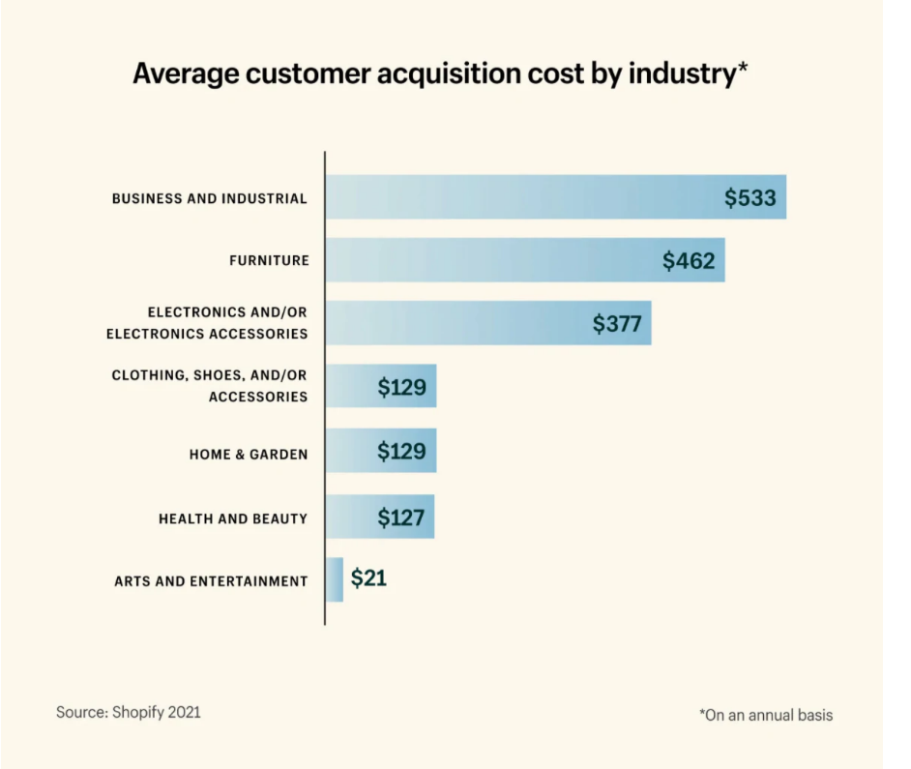
Maximize Effectiveness of Marketing Spend
Average Customer Acquisition Cost by Industry
Arts and entertainment: $21
Business and industrial: $533
Clothing, shoes, and/or accessories: $129
Electronics and/or electronics accessories: $377
Food, beverages, and tobacco products: $462
Health and beauty: $127
Home and garden: $129
Format, content and design of the information contained is not to be shared without written permission of Linda Feldman- lfeldman7370@gmail.com

Slide 193
Maximize Effectiveness of Marketing Spend
Understand your Customer Acquisition Costs (CAC)
The amount of money spent to get a new customer
Part of ROI
According to the US Small Business Administration companies that make less than $5 mil annually should allocate 7%-8% of their revenue to Marketing
Source Inuit Mailchimp
To reduce the CAC >convert leads into paying customers
Be engaged with target market and site visitors
Google analytics-abandoned shopping carts, visits, variety of tracking
Format, content and design of the information contained is not to be shared without written permission of Linda Feldman- lfeldman7370@gmail.com

Slide 194
Maximize Effectiveness of Marketing Spend
Understand Your Marketing Spend
Know your numbers
Costs
Margins
Format, content and design of the information contained is not to be shared without written permission of Linda Feldman- lfeldman7370@gmail.com

Slide 195
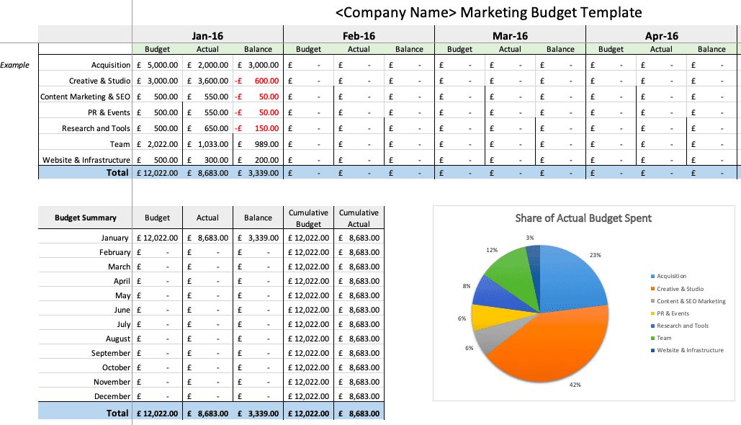
Marketing Budgeting
Format, content and design of the information contained is not to be shared without written permission of Linda Feldman- lfeldman7370@gmail.com

Slide 196
Website Budget - Example
Format, content and design of the information contained is not to be shared without written permission of Linda Feldman- lfeldman7370@gmail.com

Slide 197
Execution of Annual Plan
Action plan – time based (Short term:12-24 mo/ Long Term:3 -5 yr)
Implementation/Follow up; systematic implementation- S.M.A.R.T., monitor against set milestones, adjust to changing conditions
S.M.A.R.T. = Specific, Measurable, Achievable, Relevant, Time-bound
S.M.A.R.T. = Strategic, Measurable, Accountable, Responsible, Time-bound
EXAMPLE
What | Timeline | Channels | Key Message | Cost | Success Factor | Comments
Communication Plan | Monthly | Website-content, graphics, eCommerce ability | Look Younger | $100k | -Links brought 20k hits to site -10k hits/50% resulted in purchase | Update graphics 3x annually to stay relevant
 | Q2 & 3 | Print & Influencer | Be smart & Look Younger | $300k $25k | 5 mil impressions, 300k followers | X turned into purchases +$50mil sales
 | Q1-Q4 | Blogs, SEO | Be smart & Look Younger | $10k | Articles linked to other sites, -Traffic to website | Revisit plan every six months
Format, content and design of the information contained is not to be shared without written permission of Linda Feldman- lfeldman7370@gmail.com

Slide 198
- Become a Part of The Jewish Entrepreneur To Become a Mentor Email Robert Safren at robert@tjenetwork.com To Get Mentored, click on “Get a Mentor” on our website and fill out the form: tjenetwork.com

Slide 199
Maximize Marketing Spend

Slide 200
Maximize Effectiveness of Marketing Spend
How to maximize Marketing spend
Focus Your Marketing Efforts On Your Customer’s Needs
Know your customer, insights, find them where they are
Digital Marketing - Be relevant through valuable content
Email Marketing—Social Media Marketing—Content Marketing (Blogging)—Paid Ads Google Adwords, and Facebook ads, can be very effective marketing tools, and produce a great ROI,.
Landing Pages—Content landing pages will bring your calls to action front and center, encouraging conversion.
Webinars—cross-channel for enhanced face-to-face connection with customers and leads.
Format, content and design of the information contained is not to be shared without written permission of Linda Feldman- lfeldman7370@gmail.com

Slide 201
Maximize Effectiveness of Marketing Spend
Data
Use Data To Make Decisions
Resist the urge to shoot from the hip
Operations
Improve Your Marketing Operations
Identify what you may need to focus on, improve upon
Templates
Use Templates As Much As Possible
Easy to use, easy to understand across an organization
Repurpose
Repurpose Existing Content
Make is more powerful in its reach across all methods
Don’t constantly reinvent, that can cause confusion and dilution
Keep the message going-if it is the right one it can go for years
Project Mgmt
Improve Project Management
Get your processes in place, implement – effective & efficient
Format, content and design of the information contained is not to be shared without written permission of Linda Feldman- lfeldman7370@gmail.com

Slide 202
Maximize Effectiveness of Marketing Spend
How to maximize Marketing spend
Identify the best ways to reach your audience
Consider all of your marketing vehicles
Print, in-store, social media/digital marketing, paid influencers, etc.
Prepare a consistent message to use at all touchpoints
Ensure the visual images are consistent/same
Shoot photography at same time if possible
Give good creative direction and overview to all
Ensure content is known or at least the key messaging
Highlight must have’s and definite “no’s” if any
Create and Implement a Digital Media Investment Strategy
Be a strategic investor across digital media marketplaces.
Format, content and design of the information contained is not to be shared without written permission of Linda Feldman- lfeldman7370@gmail.com

Slide 203
Maximize Effectiveness of Marketing Spend
Track and Measure Your Results
You should always track and measure the results of your marketing activities. This way you can invest more into what’s working, eliminate what’s not, or identify areas of improvement.
Stay on message know your target audience, have a Plan, Reduce waste – recycle content, ads, photos,
Be genuine and credible, easy to contact, charitable, seek out publicity-free,
Manage on-line profiles
Sites like Yahoo! Local, Google Local, Bing Local, Manta and Yahoo! Trip Advisor all allow business owners to make profiles – for free – and take advantage of the innumerable people on the platforms searching for businesses in your local area. It’s online advertising that won’t cost you anything except a little bit of time.
Format, content and design of the information contained is not to be shared without written permission of Linda Feldman- lfeldman7370@gmail.com

Slide 204
Maximize Effectiveness of Marketing Spend
Diversify
-Diversify your advertising and sales channels to lower the cost of acquisition
-Mix it up
Niche Mktg
-Consider investing in niche channels with high engagement
-Targeted through insights
Values
-Show your customers you share the same values
-Resonate
POD’s
-Highlight your unique differentiators and values at every customer touchpoint
-Points of Difference
Positive
-Create consistent positive customer experiences
-Tone
Format, content and design of the information contained is not to be shared without written permission of Linda Feldman- lfeldman7370@gmail.com

Slide 205
Marketing Costs Tracking - Example
Know where you are spending
Consolidate if you can
Make smart decisions based on facts
Facts from seeing performance associated with marketing efforts
Track & Measure
Format, content and design of the information contained is not to be shared without written permission of Linda Feldman- lfeldman7370@gmail.com

Slide 206
Marketing Modules Topics Covered
What is Marketing?
What’s the difference between Advertising & Marketing?
Marketing;
Components, Funnel, 4 P’s,, Inbound/Outbound, Consumer Insights, Branding
Marketing Strategy & Planning
Planning Process, Direction, Execution
Innovation
Awareness
Digital Marketing vs Social Media
SEO & Social Media
Marketing Tools & Tactics
KPI’s- Key Performance Indicators
Marketing Budgeting & Marketing Spend
How to maximize Marketing costs
Format, content and design of the information contained is not to be shared without written permission of Linda Feldman- lfeldman7370@gmail.com

Slide 207
A dream written down with a date becomes a Goal
A goal broken down into steps becomes a Plan.
A plan backed by action becomes REALITY
Format, content and design of the information contained is not to be shared without written permission of Linda Feldman- lfeldman7370@gmail.com

Slide 208
- Become a Part of The Jewish Entrepreneur To Become a Mentor Email Robert Safren at robert@tjenetwork.com To Get Mentored, click on “Get a Mentor” on our website and fill out the form: tjenetwork.com

Slide 209
Access Strategic Advisors LLC
Linda Feldman
Provide access to effective strategic planning methodology and skills guiding organizations to Plan, then Build their success
Lfeldman7370@gmail.com

